Slide 1
SVM (cont.)
Main reference: Chapter 5 of Géron, A. (2019). Hands-on machine learning with Scikit-Learn, Keras, and TensorFlow.

Slide 2




SVM Regression

Slide 3


Idea
SVM classification: find a model (decision boundary) with large margins and less violations.
SVM regression: find a model (hypothesis) that

Slide 4


Implementation
SVM regressor tries to
In sklearn.svm.LinearSVR, smaller epsilon ➔
>> Code

Slide 5
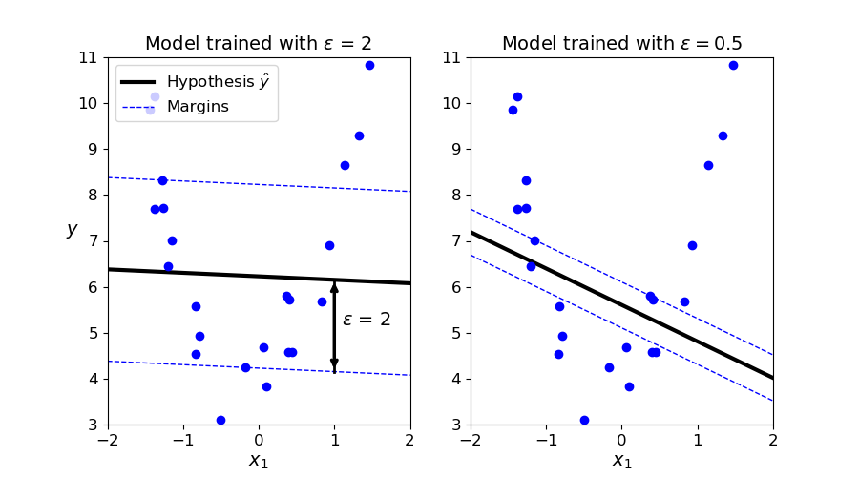






Which one fits the data better?

Slide 6





However
They are both
A good model should:
>> Code

Slide 7
(A little bit) Math behind SVM

Slide 8






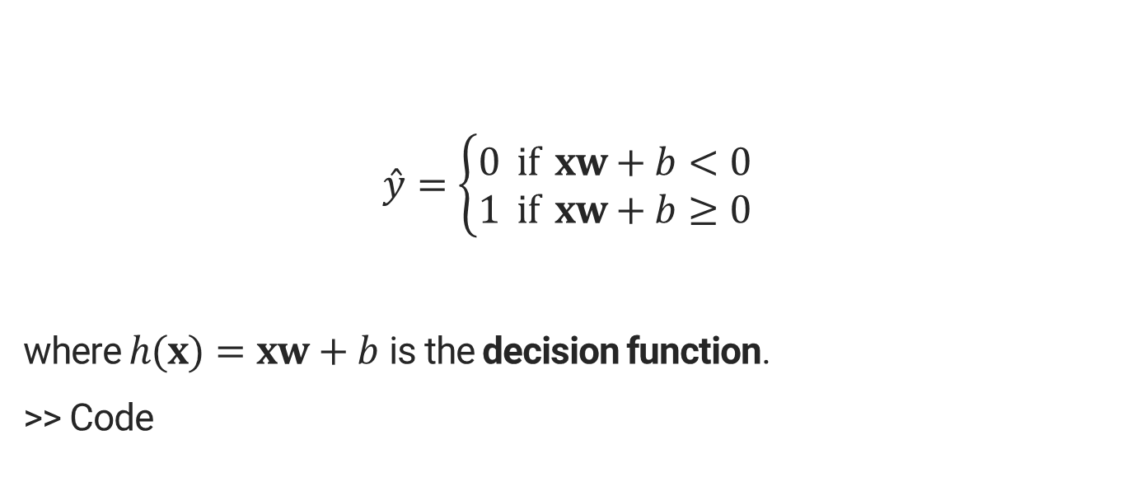


Hypothesis function
$$\hat{y}=\left\{\begin{aligned}0 if xw+b<0 \\ 1 if xw+b≥0\end{aligned}\right.$$
where $h(x)=xw+b$ is the decision function.
>> Code

Slide 9
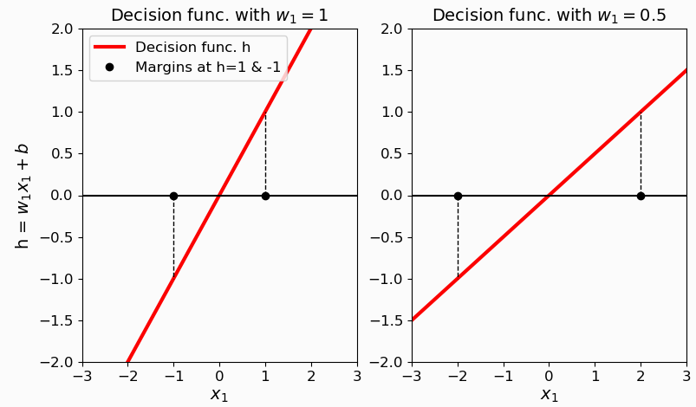








Weights and margins

Slide 10





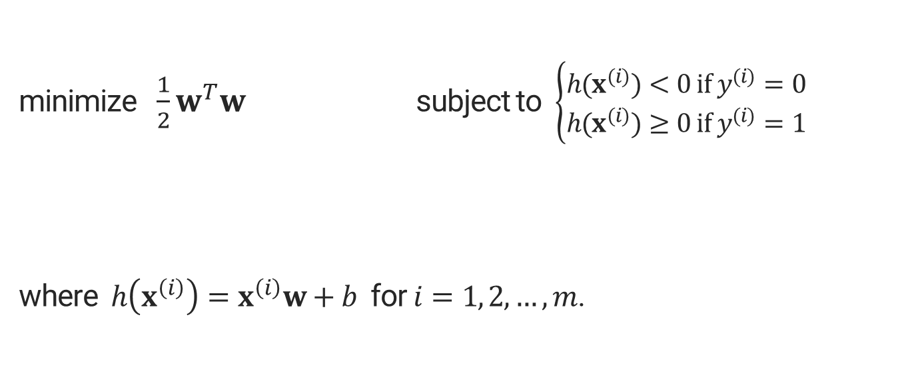

Objective function of a hard margin classifier
minimize $\frac{1}{2}w^{T}w$ subject to $\left\{\begin{aligned}h(x^{(i)})<0 if y^{(i)}=0 \\ h(x^{(i)})≥0 if y^{(i)}=1\end{aligned}\right.$
where $h\left(x^{\left(i\right)}\right)=x^{\left(i\right)}w+b$ for $i=1, 2,…,m$.

Slide 11









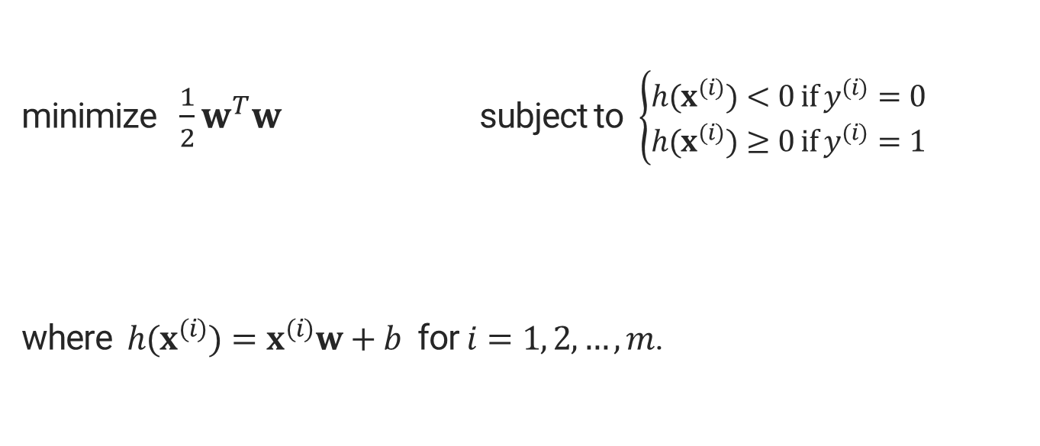





Objective function of a soft margin classifier
minimize $\frac{1}{2}w^{T}w$ subject to $\left\{\begin{aligned}h(x^{(i)})<0 if y^{(i)}=0 \\ h(x^{(i)})≥0 if y^{(i)}=1\end{aligned}\right.$
where $h(x^{(i)})=x^{(i)}w+b$ for $i=1, 2,…,m$.

Slide 12










How to solve this constrained problem?
Primal problem:
Dual problem:
Under some conditions:
The dual of SVM problem:

Slide 13
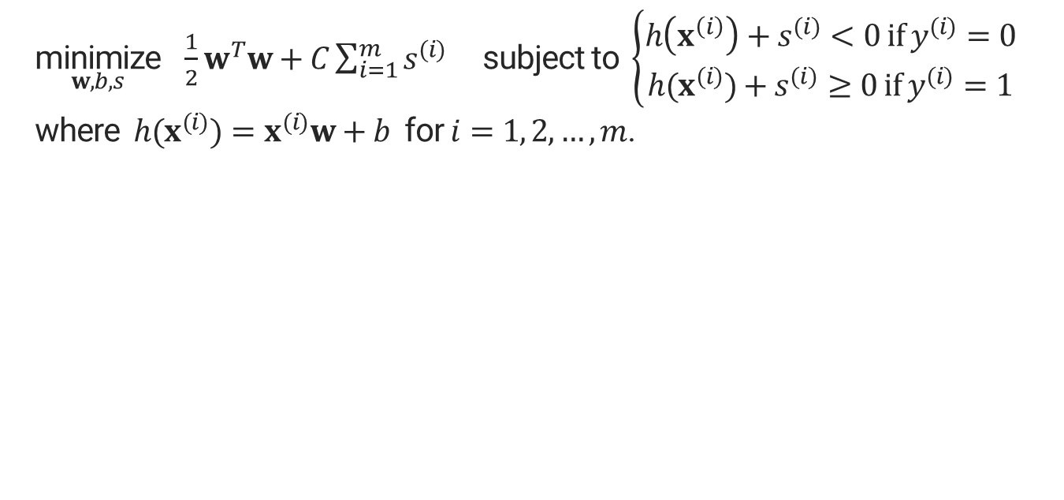
SVM primal problem
$\underset{w,b, s}{\text{minimize}} \frac{1}{2}w^{T}w+C\sum_{i=1}^{m}{s^{(i)}}$ subject to $\left\{\begin{aligned}h\left(x^{\left(i\right)}\right)+s^{(i)}<0 if y^{(i)}=0 \\ h(x^{(i)})+s^{(i)}≥0 if y^{(i)}=1\end{aligned}\right.$
where $h(x^{(i)})=x^{(i)}w+b$ for $i=1, 2,…,m$.

Slide 14






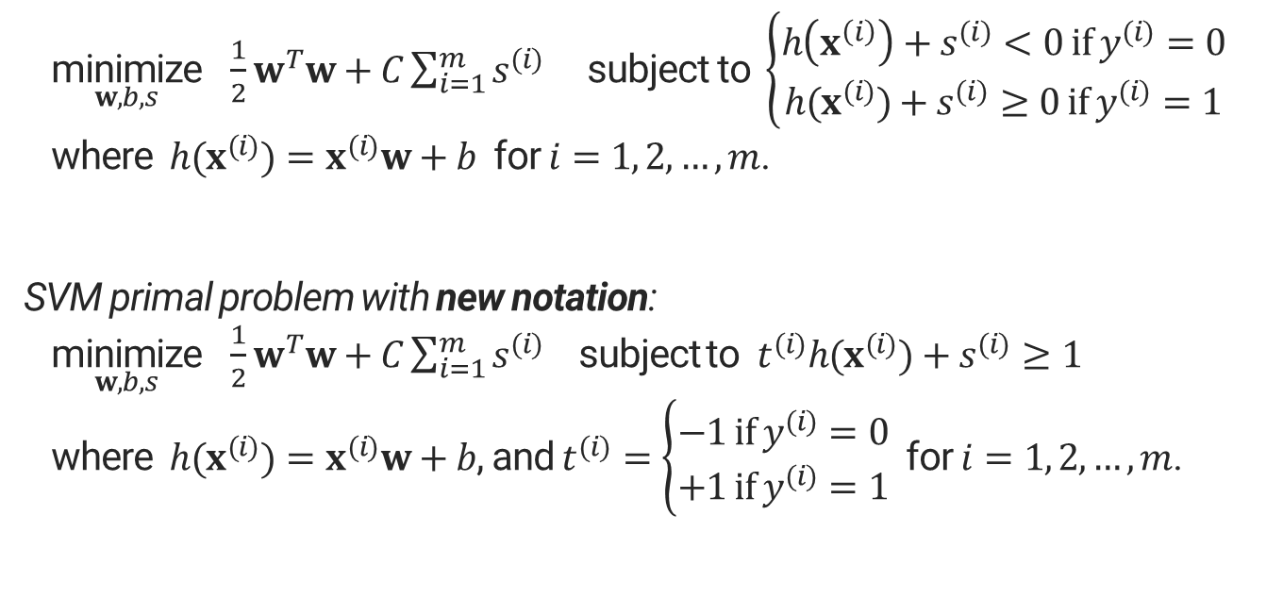
SVM primal problem (with new notation)
$\underset{w,b, s}{\text{minimize}} \frac{1}{2}w^{T}w+C\sum_{i=1}^{m}{s^{(i)}}$ subject to $\left\{\begin{aligned}h\left(x^{\left(i\right)}\right)+s^{(i)}<0 if y^{(i)}=0 \\ h(x^{(i)})+s^{(i)}≥0 if y^{(i)}=1\end{aligned}\right.$
where $h(x^{(i)})=x^{(i)}w+b$ for $i=1, 2,…,m$.
SVM primal problem with new notation:
$\underset{w,b, s}{\text{minimize}} \frac{1}{2}w^{T}w+C\sum_{i=1}^{m}{s^{(i)}}$ subject to $t^{(i)}h(x^{(i)})+s^{(i)}≥1$
where $h(x^{(i)})=x^{(i)}w+b$, and $t^{(i)}=\left\{\begin{aligned}−1 if y^{(i)}=0 \\ +1 if y^{(i)}=1\end{aligned}\right.$ for $i=1, 2,…,m$.

Slide 15


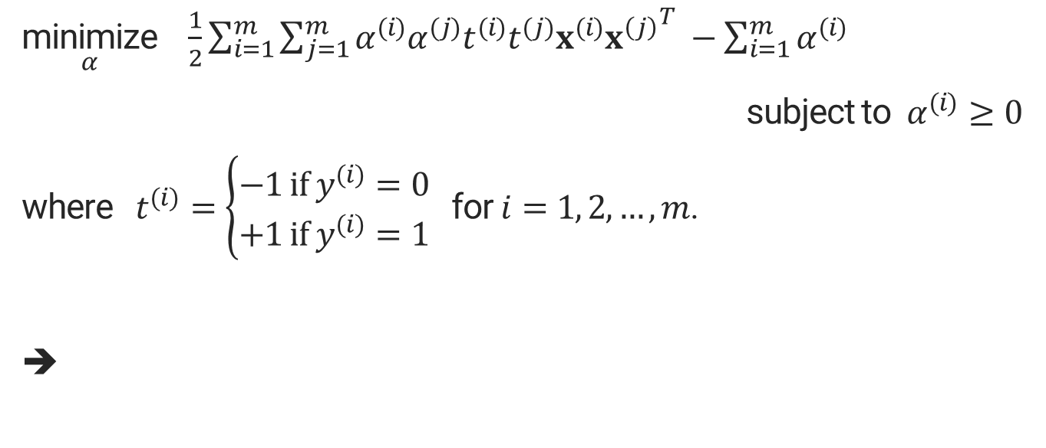



SVM dual problem
$\underset{α}{\text{minimize}}$ $\frac{1}{2}\sum_{i=1}^{m}{\sum_{j=1}^{m}{α^{(i)}α^{(j)}t^{(i)}t^{(j)}x^{(i)}{x^{\left(j\right)}}^{T}} }−\sum_{i=1}^{m}{α^{(i)}}$
subject to $α^{(i)}≥0$
where $t^{(i)}=\left\{\begin{aligned}−1 if y^{(i)}=0 \\ +1 if y^{(i)}=1\end{aligned}\right.$ for $i=1, 2,…,m$.
➔

Slide 16
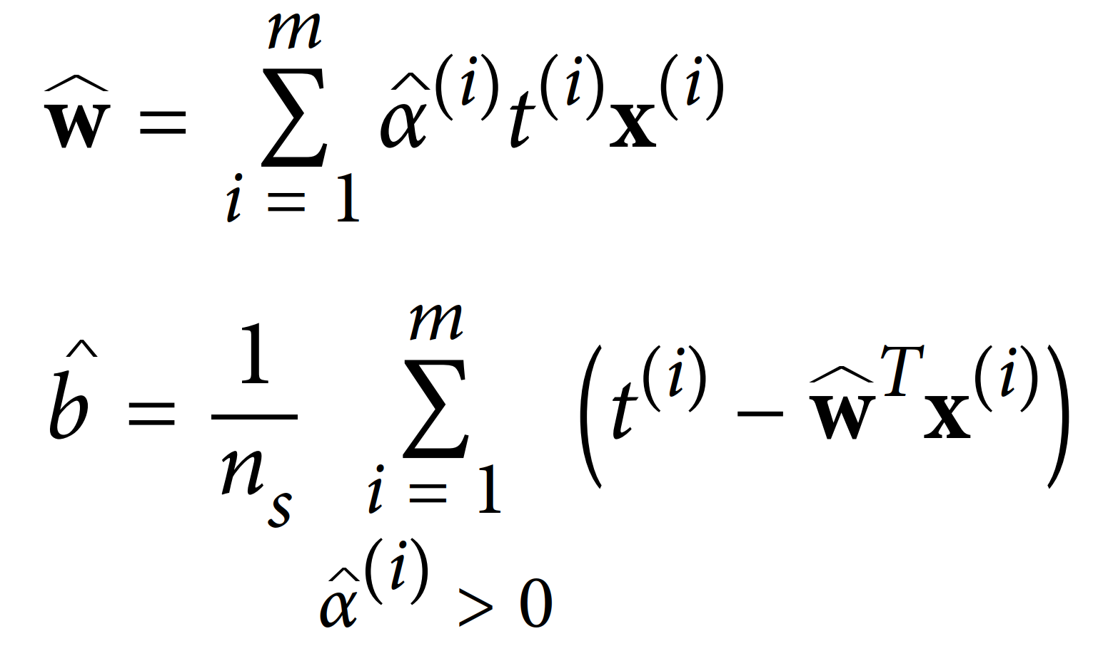
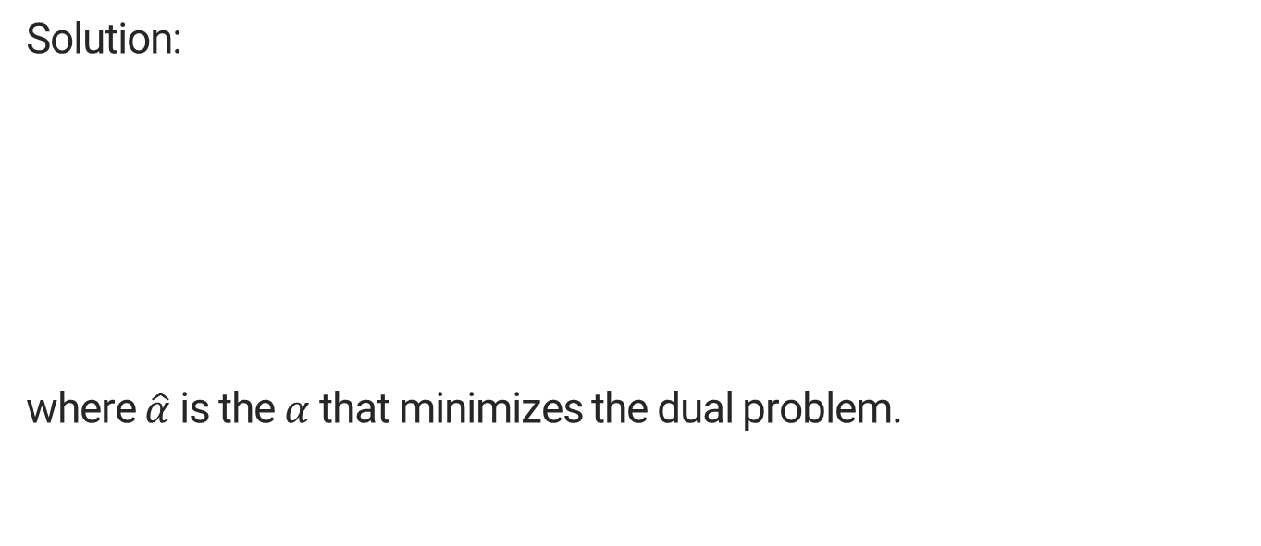

SVM dual problem
Solution:
where $\hat{α}$ is the $α$ that minimizes the dual problem.

Slide 17



SVM dual problem

Slide 18
Math behind the Kernelized SVM

Slide 19
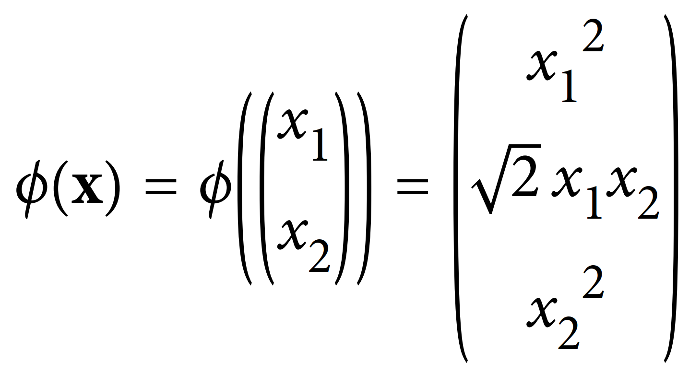






Kernel trick
Recall: Kernel trick gives the same solution without explicitly adding features.
Consider the polynomial transformation:

Slide 20
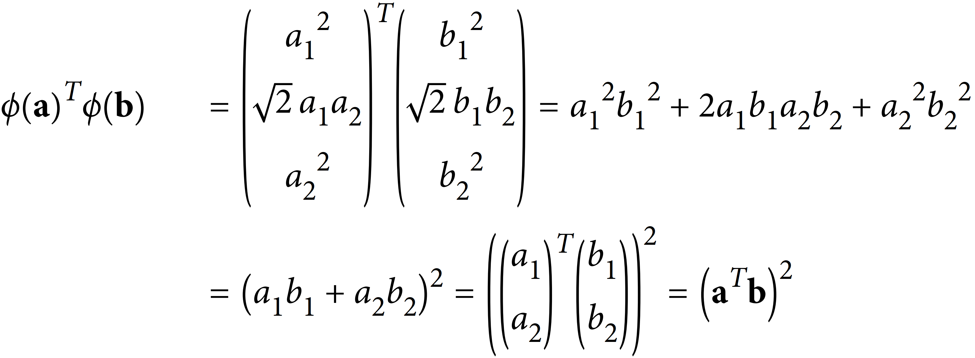


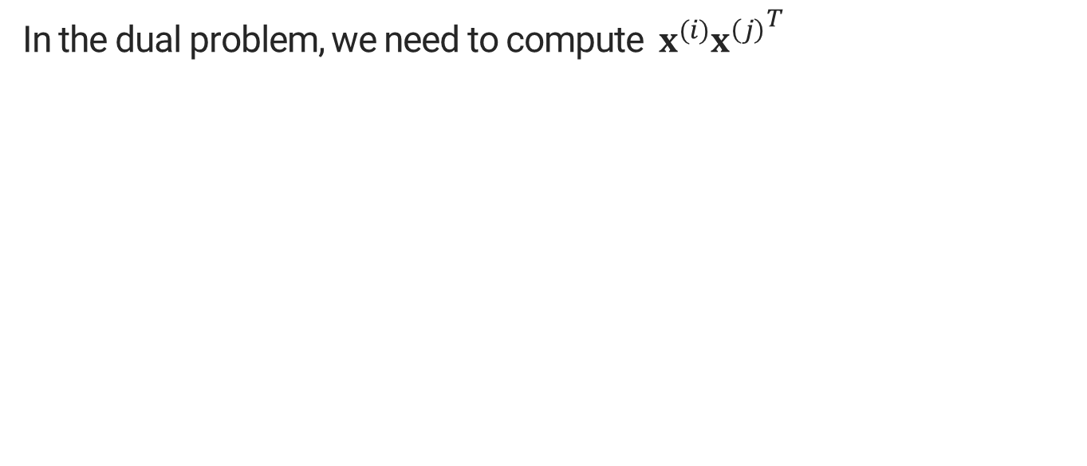





Kernel trick
In the dual problem, we need to compute $x^{(i)}{x^{\left(j\right)}}^{T}$
T
T

Slide 21
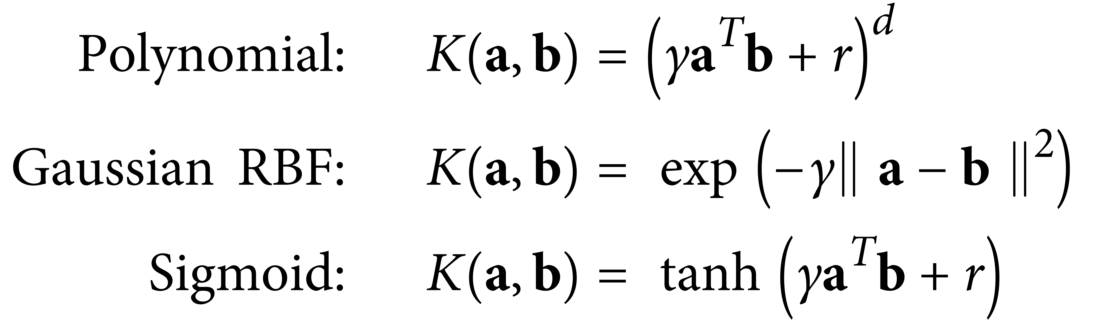
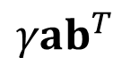
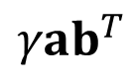

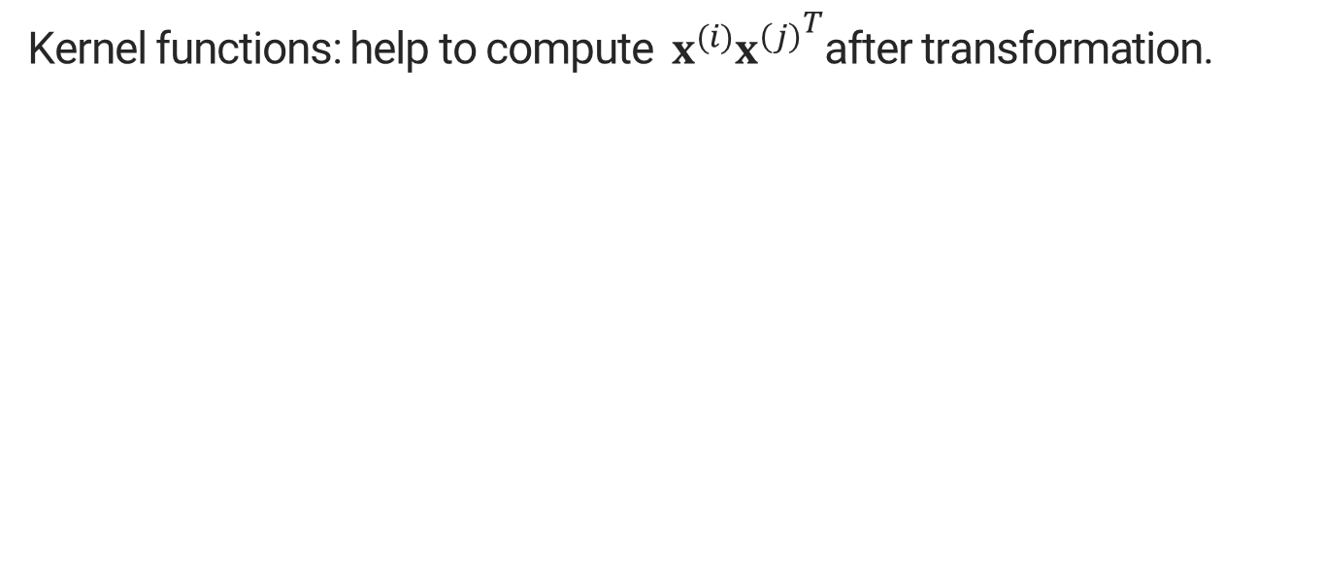

Kernel functions
Kernel functions: help to compute $x^{(i)}{x^{\left(j\right)}}^{T}$after transformation.
$$γab^{T}$$
$$γab^{T}$$
Credit: (Géron, 2019)

Slide 22
Solving SVM using Gradient descent

Slide 23
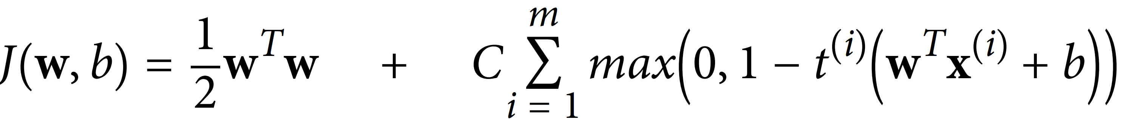



Cost function (for linear SVM)
For large-scale non-linear problems:

